Slide 1
Data Science
Week 1:
Building Blocks
Lewen and Srikar
Notes:
Okay, but what even is data science in the first place??

Slide 2
What is data science?
the study of data to extract knowledge and insights
Organize data into clear and concise information
Visualize results for target audience
Notes:
Transition
But we still have not answered the big question: What are we going to do?

Slide 3
Our Plan
Learning SQL - w3schools
Acquiring a quality and standard dataset - Kaggle
Accessing cloud database - Amazon AWS or Microsoft Azure (RDBMS)
Visualizing information clearly - R
Applying data
Notes:
Kaggle - open source platform
RDBMS - relational database management system
Use R cuz Rama said so
“Why R” “it’s beautiful” “but why R” “Because im comfortable in it”
Transition: So let’s take a look at the first step: Learning SQL

Slide 4
1. Learning SQL
SQL
Python
SELECT * FROM heart.table #checks all of database heart
WHERE restingbpm < 80; #condition
SELECT PatientID FROM heart.table #checks patientIDs
WHERE restingbpm > 80; #condition
INSERT INTO Customers(‘Alex’)
VALUES (‘10’)
#Inserts row under with new patientID and Name
for i in range(len(heart)): #checks the entire tuple ‘heart’
if heart[i][2] < 80: #condition
print(heart[i]) #print
else:
pass
for i in range(len(heart)): #checks the entire tuple ‘heart’
if heart[i][2] > 80: #condition
print(heart[i][1])#print
else:
pass
Notes:
SQL vs Python
SQL is standard way to handle large data sets and it helps in querying the required output
Python has difficulty in accessing and handling data sets
Python works better with general coding, but not data sets
Handling data sets is like chopping vegetables
SQL is like a knife, it cuts easily but isn’t much help for anything but cutting cucumbers
Python is like a hand, it’s good for general use but isn’t specialized for chopping vegetables

Slide 5
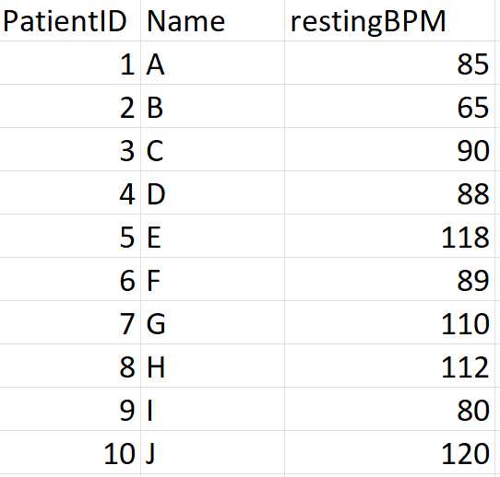
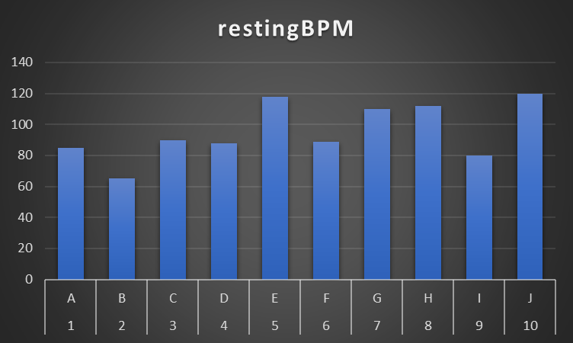
4. Example Data
Notes:
Basic example data and visualization for target audience (medical experts, doctors)

Slide 6
Explain the present.
Predict the future.
Notes:
Our goal, like any data scientist, is to do two simple things: Explain the present and predict the future. In today’s world, data is like a large flowing river. Massive amounts of data are generated every second by the 5 billion internet users. We are dipping a small cup to grasp a fraction of that data to help people make informed deciions

